Slide 1
SEEMINGLY UNRELATED REGRESSION
INFERENCE AND TESTING
Sunando Barua
Binamrata Haldar
Indranil Rath
Himanshu Mehrunkar

Slide 2
Four Steps of Hypothesis Testing
1. Hypotheses:
Null hypothesis (H₀):
A statement that parameter(s) take specific value (Usually: “no effect”)
Alternative hypothesis (H₁):
States that parameter value(s) falls in some alternative range of values
(“an effect”)
Test Statistic:
Compares data to what H₀ predicts, often by finding the number of standard errors between sample point estimate and H₀ value of parameter. For example, the test stastics for Student’s t-test is

Slide 3
3. P-value (P):
A probability measure of evidence about H_{0.} The probability (under presumption that H₀ is true) the test statistic equals observed value or value even more extreme in direction predicted by H₁.
The smaller the P-value, the stronger the evidence against H_{0.}
4. Conclusion:
If no decision needed, report and interpret P-value
If decision needed, select a cutoff point (such as 0.05 or 0.01) and reject H₀ if P-value ≤ that value

Slide 4
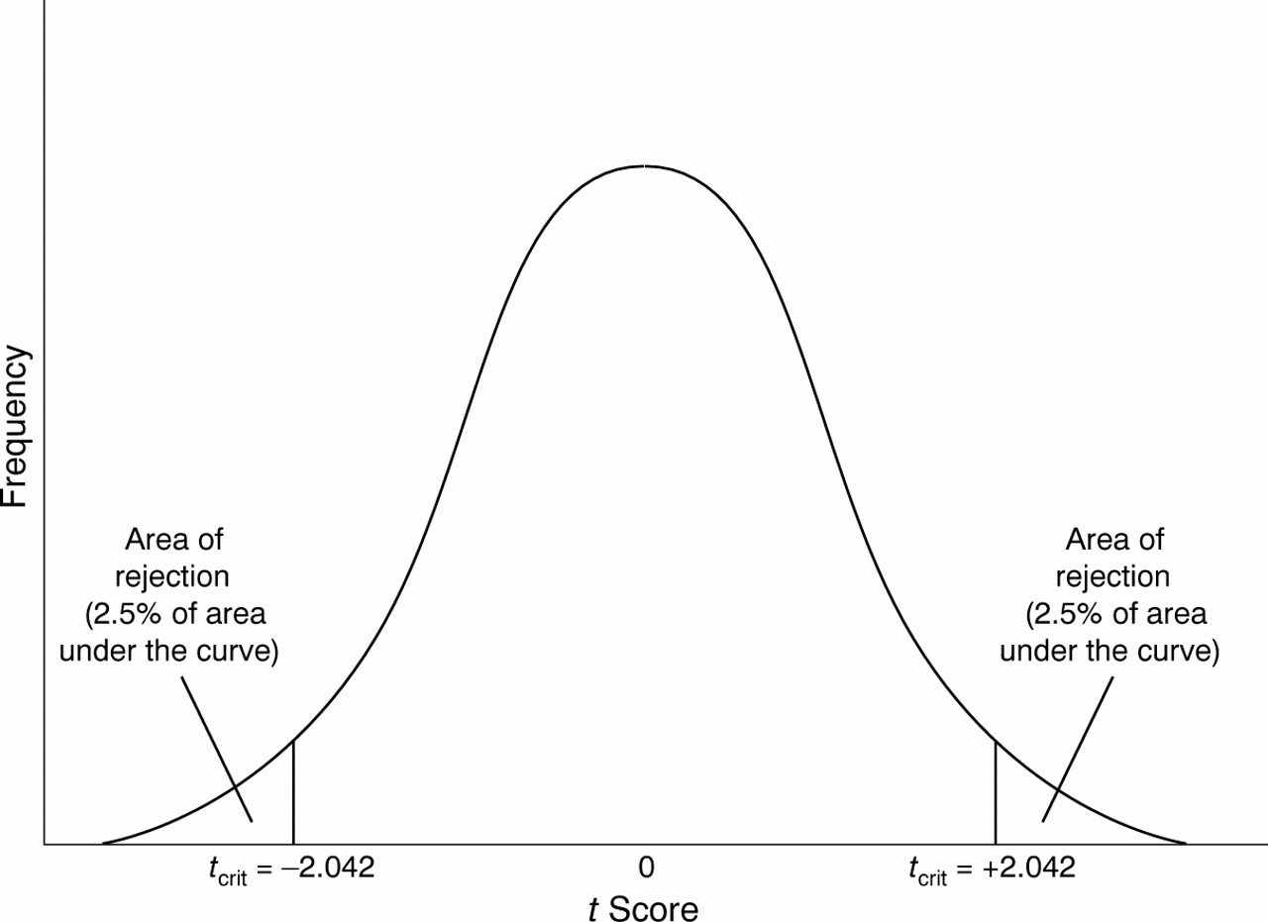

Slide 5
Seemingly Unrelated Regression
Firm | Inv(t) | mcap(t-1) | nfa(t-1) | a(t-1) | 1
Ashok Leyland | i_a | mcap_a | nfa_a | a_a
Mahindra & Mahindra | i_m | mcap_m | nfa_m | a_m
Tata Motors | i_t | mcap_t | nfa_t | a_t
Inv(t) : Gross investment at time ‘t’
mcap(t-1): Value of its outstanding shares at time ‘t-1’ (using closing price of NSE)
nfa(t-1) : Net Fixed Assets at time ‘t-1’
a(t-1) : Current assets at time ‘t-1’

Slide 6
System Specification

Slide 7
I = Xβ + Є
E(Є)=0, E(Є Є’) = ∑ ⊗ I17

Slide 8
SIMPLE CASE [σ_{ij}=0, σ_{ii}=σ² => ∑ ⊗ I₁₇ = σ²I₁₇]
_{Estimation:}
OLS estimation method can be applied to the individual equations of the SUR model
_{OLS} = (X’X)⁻¹ X’I
SAS command :
proc syslin data=sasuser.ppt sdiag sur;
al:model i_a=mcap_a nfa_a a_a;
mm:model i_m=mcap_m nfa_m a_m;
tata:model i_t=mcap_t nfa_t a_t;
run;
proc reg data=sasuser.ppt;
al:model i_a=mcap_a nfa_a a_a;
mm:model i_m=mcap_m nfa_m a_m;
tata:model i_t=mcap_t nfa_t a_t;
run;

Slide 9
Estimated equations
Ashok Leyland: = -2648.66 + 0.07mcap_a + 0.14nfa_a + 0.11a_a
Mahindra & Mahindra: = -15385 + 0.12mcap_m + 0.97nfa_m + 0.88a_m
Tata Motors: = -55189 - 0.18mcap_t + 2.25nfa_t + 1.13a_t

Slide 10
Regression results for Mahindra & Mahindra
Dependent Variable: i_m investment
Keeping the other explanatory variables constant, a 1 unit increase in mcap_m at ‘t-1’ results in an average increase of 0.1156 units in i_m at ‘t’.
Similarly, a 1 unit increase in nfa_m at ‘t-1’ results in an average increase of 0.9741 units in i_m and a 1 unit increase in a_m at ‘t-1’ results in an average increase of 0.8826 units in i_m at ‘t’.
From P-values, we can see that at 10% level of significance, the estimate of the mcap_m and a_m coefficients are significant.
Parameter Estimates
Variable | Label | DF | Parameter Estimate | Standard Error | t Value | Pr > |t|
Intercept | Intercept | 1 | -15385 | 4144.87358 | -3.71 | 0.0026
mcap_m | Mkt. cap. | 1 | 0.11555 | 0.02870 | 4.03 | 0.0014
nfa_m | Net fixed assets | 1 | 0.97411 | 0.61976 | 1.57 | 0.1400
a_m | assets | 1 | 0.88264 | 0.44337 | 1.99 | 0.0680

Slide 11
GENERAL CASE [∑ is free ]
Estimation:
We need to use the GLS method of estimation since the error variance-covariance matrix (∑) of the SUR model is not equal to σ²I₁₇.
_{GLS}=[X’(∑ ⊗ I17 )⁻¹X]⁻¹ X ’(∑ ⊗ I17 )⁻¹ I
SAS command :
proc syslin data=sasuser.ppt sur;
al:model i_a=mcap_a nfa_a a_a;
mm:model i_m=mcap_m nfa_m a_m;
tata:model i_t=mcap_t nfa_t a_t;
run;

Slide 12
Estimated Equations
Ashok Leyland: = -1630.7 + 0.10mcap_a + 0.21nfa_a – 0.065a_a
Mahindra & Mahindra: = -14236.2 + 0.126mcap_m + 1.16nfa_m + 0.67a_m
Tata Motors: = -50187.1 - 0.13mcap_t + 2.1nfa_t + 0.96a_t

Slide 13
Regression results for Mahindra & Mahindra
Dependent Variable: i_m investment
Keeping the other explanatory variables constant, a 1 unit increase in mcap_m at ‘t-1’ results in an average increase of 0.126 units in i_m at ‘t’.
Similarly, a 1 unit increase in nfa_m at ‘t-1’ results in an average increase of 1.16 units in i_m and a 1 unit increase in a_m at ‘t-1’ results in an average increase of 0.67 units in i_m at ‘t’.
From P-values, we can see that at 10% level of significance, the estimate of the mcap_m and nfa_m coefficients are significant.
Parameter Estimates
Variable | DF | Parameter Estimate | Standard Error | t Value | Pr > |t| | Variable Label
Intercept | 1 | -14236.2 | 4103.296 | -3.47 | 0.0042 | Intercept
mcap_m | 1 | 0.125949 | 0.028336 | 4.44 | 0.0007 | mktcap
nfa_m | 1 | 1.115600 | 0.605658 | 1.84 | 0.0884 | netfixedassets
a_m | 1 | 0.673922 | 0.431265 | 1.56 | 0.1421 | assets

Slide 14
HYPOTHESIS TESTING
The appropriate framework for the test is the notion of constrained-unconstrained estimation

Slide 15
SIMPLE CASE 1 (σ_{ij}=0,σ_{ii}=σ²)
ASHOK LEYLAND AND MAHINDRA & MAHINDRA
VARIABLE NAME | DESCRIPTION | VALUE
σ_{ii} | Variance | σ²
σ_{ij} | Contemporaneous Covariance | 0
N | Number of Firms | 2
T₁ | Number of observations of Ashok Leyland | 17
T₂ | Number of observations of Mahindra & Mahindra | 17
K | Number of Parameters | 4
H₀ | β₁ = β₂
H₁ | β₁ ≠ β₂

Slide 16
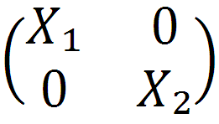
Unconstrained Model
= +
Constrained Model
= +
H₀ = β₁ = β₂

Slide 17
= I_{i} - _{i}
_{i}
’
SS_{i} = _{i i}
SAS Command used to calculate Sum of Squares:
Unconstrained Model
proc syslin data=sasuser.ppt sdiag sur;
al:model i_a=mcap_a nfa_a a_a;
mm:model i_m=mcap_m nfa_m a_m;
run;
Constrained Model
proc syslin data=sasuser.ppt sdiag sur;
al:model i_a=mcap_a nfa_a a_a;
mm:model i_m=mcap_m nfa_m a_m;
joint: srestrict al.nfa_a=mm.nfa_m,al.a_a=mm.a_m, al.intercept = mm.intercept;
run;

Slide 18
Unconstrained Model | Constrained Model
SS_{al} = 33246407 ; SS_{mm} = 566598063.4 SS_{uc} = SS_{al} + SS _{mm} = 599844470 DOF_{uc} = T1 + T2 – K – K = 26 | SS_{c} = 1934598017 DOF_{c} = T1 + T2 –K = 30
Number of restrictions = DOF_{c} - DOF_{uc} = 4
F_{cal} = [(SS_{c} – SS_{uc})/number of restrictions]/ [SS_{uc}/DOF_{uc}] ~ F (4,26)
= 14.4636
The F_{tab} value at 5% LOS is 2.74
Decision Criteria : We reject H₀ when F_{cal} > F_{tab}
Therefore, we reject H₀ at 5% LOS
Not all the coefficients in the two coefficient matrices are equal.

Slide 19
SIMPLE CASE 2 (σ_{ij}=0,σ_{ii}=σ²)
ASHOK LEYLAND, MAHINDRA & MAHINDRA AND TATA MOTORS
VARIABLE NAME | DESCRIPTION | VALUE
σ_{ii} | Variance | σ²
σ_{ij} | Contemporaneous Covariance | 0
N | Number of Firms | 3
T₁ | Number of observations of Ashok Leyland | 17
T₂ | Number of observations of Mahindra & Mahindra | 17
T₃ | Number of observations of Tata Motors | 17
K | Number of Parameters | 4
H₀ | β₁ = β₂ = β₃
H₁ | β₁ ≠ β₂ ≠ β₃

Slide 20
SAS Command used to calculate Sum of Squares:
Unconstrained Model
proc syslin data=sasuser.ppt sdiag sur;
al:model i_a=mcap_a nfa_a a_a;
mm:model i_m=mcap_m nfa_m a_m;
tata:model i_t=mcap_t nfa_t a_t;
run;
Constrained Model
proc syslin data=sasuser.ppt sdiag sur;
al:model i_a=mcap_a nfa_a a_a;
mm:model i_m=mcap_m nfa_m a_m;
tata:model i_t=mcap_t nfa_t a_t;
joint: srestrict al.mcap_a = mm.mcap_m = tata.mcap_t, al.nfa_a = mm.nfa_m = tata.nfa_t, al.a_a = mm.a_m = tata.a_t, al.intercept = mm.intercept = tata.intercept;
run;

Slide 21
Unconstrained Model | Constrained Model
SS_{al} = 33246407 ; SS_{mm} = 566598063.4 SS_{tata} =13445921889 SS_{uc} = SS_{al} + SS _{mm} + SS_{tata} = 14045766359 DOF_{uc} = T₁ + T₂ +T₃– K – K - K= 39 | SS_{c} = 35161183397 DOF_{c} = T₁ + T₂ + T₃ – K = 47
Number of restrictions = DOF_{c} - DOF_{uc} = 8
F_{cal} = [(SS_{c} – SS_{uc})/number of restrictions]/ [SS_{uc}/DOF_{uc}] ~ F (8,39)
= 7.329
The F_{tab} value at 5% LOS is 2.18
Decision Criteria : We reject H₀ when F_{cal} > F_{tab}
Therefore, we reject H₀ at 5% LOS.
Not all the coefficients in the two coefficient matrices are equal.

Slide 22
SIMPLE CASE 3 (σ_{ij}=0,σ_{ii}=σ²)
ASHOK LEYLAND AND MAHINDRA & MAHINDRA
VARIABLE NAME | DESCRIPTION | VALUE
σ_{ii} | Variance | σ²
σ_{ij} | Contemporaneous Covariance | 0
N | Number of Firms | 2
T₁ | Number of observations of Ashok Leyland | 17
T₂ | Number of observations of Mahindra & Mahindra | 2
K | Number of Parameters | 4
T₂ < K
H₀ | β₁ = β₂
H₁ | β₁ ≠ β₂

Slide 23
NOTE:
of Unconstrained Model cannot be estimated using OLS model because (X’X) is not invertible as = 0
SS_{uc} = SS₁ + SS₂ ; SS₁ can be obtained but SS₂ cannot be calculated due to insufficient degrees of freedom.
However, we can estimate the model for Ashok Leyland by OLS
(SS_{uc} = SS₁ ; T₁-K degrees of freedom)
Under the null hypothesis, we estimate the Constrained Model using T₁ + T₂ observations.
(SS_{c} ; T1 + T2 – K degrees of freedom)
So, we can do the test even when T₂ = 1
SAS Command for Constrained Model:
proc syslin data=sasuser.file1 sdiag sur;
al: model i=mcap nfa a;
run;

Slide 24
Unconstrained Model | Constrained Model
SS_{al} = 33246407 SS_{uc} = SS_{al} = 33246407 DOF_{uc} = T1 – K = 13 | SS_{c} = 56881219.77 DOF_{c} = T1 + T2 –K = 15
Number of restrictions = DOF_{c} - DOF_{uc} = 2
F_{cal} = [(SS_{c} – SS_{uc})/number of restrictions]/ [SS_{uc}/DOF_{uc}] ~ F (2,13)
= 4.6208
The F_{tab} value at 5% LOS is 3.81
Decision Criteria : We reject H₀ when F_{cal} > F_{tab}
Therefore, we reject H₀ at 5% LOS
Not all the coefficients in the two coefficient matrices are equal.

Slide 25
SIMPLE CASE 4 (PARTIAL TEST)
Y₁= X_{a1} β_{a1} + X_{a2}β_{a2} + ε₁ β₁=
(T₁x1) [T₁x(k₁-S)][(k₁-S)x1] (T₁xS) (Sx1) (T₁x1)
Y₂ = X_{b1}β_{b1} + X_{b2}β_{b2} + ε₂
(T₂x1) [T₂x(k₂-S)][(k₁-S)x1] (T₂xS) (Sx1) (T₁x1)
β₁ = β₁₁ β₁₂ β₁₃ β₁₄ β₁₅ β₁₆
β₂ = β₂₁ β₂₂ β₂₃ β₂₄ β₂₅ β₂₆ β₂₇
β₁ = β₁₁ β₁₃ β₁₅ β₁₆ β₁₂ β₁₄
β₂ = β₂₁ β₂₃ β₂₄ β₂₅ β₂₆ β₂₂ β₂₇
a1
β₂ =
b1
a2
b2
Need to be compared

Slide 26
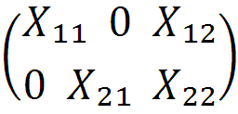
Ashok Leyland and Mahindra & Mahindra
Unconstrained Model
I₁ = X_{a1}β_{a1} + X_{a2} β_{a2} + ε₁
I₂ = X_{b1}β_{b1} + X_{b2}β_{b2} + ε₂
Constrained Model
H₀ | β_{a2} = β_{b2} = β
H₁ | β_{a2} ≠ β_{b2}
[]
₌
+

Slide 27
SAS Command used to calculate Sum of Squares:
Unconstrained Model
proc syslin data=sasuser.ppt sdiag sur;
al:model i_a=mcap_a nfa_a a_a;
mm:model i_m=mcap_m nfa_m a_m;
run;
Constrained Model
proc syslin data=sasuser.ppt sdiag sur;
al:model i_a=mcap_a nfa_a a_a;
mm:model i_m=mcap_m nfa_m a_m;
joint: srestrict al.nfa_a=mm.nfa_m,al.a_a=mm.a_m;
run;

Slide 28
Unconstrained Model | Constrained Model
SS_{uc} = 26 DOF_{uc} = T₁ + T₂ – K – K = 26 | SS_{c} = 1.5662 x 28 = 43.85 DOF_{c} = T₁ + T₂ – (K₁ – S) – (K₂ - S) = 28
Number of restrictions = DOF_{c} - DOF_{uc} = S = 2
F_{cal} = [(SS_{c} – SS_{uc})/number of restrictions]/ [SS_{uc}/DOF_{uc}] ~ F (2,26)
= 8.927
The F_{tab} value at 5% LOS is 3.37
Decision Criteria : We reject H₀ when F_{cal} > F_{tab}
Therefore, we reject H₀ at 5% LOS
Not all the coefficients in the two coefficient matrices are equal.

Slide 29
GENERAL CASE (∑ is free)
ASHOK LEYLAND, MAHINDRA & MAHINDRA AND TATA MOTORS
VARIABLE NAME | DESCRIPTION | VALUE
σ_{ii} | Variance | σ_{i}²
σ_{ij} | Contemporaneous Covariance | σ_{ij}
N | Number of Firms | 3
T₁ | Number of observations of Ashok Leyland | 17
T₂ | Number of observations of Mahindra & Mahindra | 17
T₃ | Number of observations of Tata Motors | 17
K | Number of Parameters | 4
H₀ | β₁ = β₂ = β₃
H₁ | Not H₀

Slide 30
SAS Command used to calculate Sum of Squares:
Unconstrained Model
proc syslin data=sasuser.ppt sur;
al:model i_a=mcap_a nfa_a a_a;
mm:model i_m=mcap_m nfa_m a_m;
tata:model i_t=mcap_t nfa_t a_t;
run;
Constrained Model
proc syslin data=sasuser.ppt sur;
al:model i_a=mcap_a nfa_a a_a;
mm:model i_m=mcap_m nfa_m a_m;
tata:model i_t=mcap_t nfa_t a_t;
joint: srestrict al.mcap_a = mm.mcap_m = tata.mcap_t, al.nfa_a = mm.nfa_m = tata.nfa_t, al.a_a = mm.a_m = tata.a_t, al.intercept = mm.intercept = tata.intercept;
run;

Slide 31
Unconstrained Model | Constrained Model
SS_{uc} = 0.8704 x 39 = 33.946 DOF_{uc} = T1 + T2 + T3 – K – K – K = 39 | SS_{c} = 4.4821 x 47 = 210.659 DOF_{c} = T1 + T2 + T3 – K = 47
Number of restrictions = DOF_{c} - DOF_{uc} = 8
F_{cal} = [(SS_{c} – SS_{uc})/number of restrictions]/ [SS_{uc}/DOF_{uc}] ~ F (8,39)
= 25.38
The F_{tab} value at 5% LOS is 2.18
Decision Criteria : We reject H₀ when F_{cal} > F_{tab}
Therefore, we reject H₀ at 5% LOS
Not all the coefficients in the two coefficient matrices are equal.

Slide 32
CHOW TEST
MAHINDRA & MAHINDRA (1996-2005 ; 2006-2012)
VARIABLE NAME | DESCRIPTION | VALUE
σ_{ii} | Variance | σ_{i}²
σ_{ij} | Contemporaneous Covariance | σ_{ij}
T₁ | Number of observations for Period1: 1996-2005 | 10
T₂ | Number of observations for Period 2: 2006-2012 | 7
K | Number of Parameters | 4
Period 1:1996-2005 as β₁₁
Period 2:2006-2012 as β₁₂
H₀ | β₁₁ = β₁₂
H₁ | Not H₀

Slide 33
SAS Command:
proc autoreg data=sasuser.ppt;
mm:model i_m=mcap_m nfa_m a_m /chow=(10);
run;
Test Result:
Structural Change Test
Test | Break Point | Num DF | Den DF | F Value | Pr > F
Chow | 10 | 4 | 9 | 7.26 | 0.0068
Inference:
F(4,9) = 3.63 at 5% LOS ; Fcal = 7.26
Also, P-value = 0.0068
As F(4,9) Fcal (also P-value is too low), we reject H0 at 5% LOS

Slide 34
THANK YOU!

