Slide 1
LIMITED DEPENDENT VARIABLE MODELS
-Copyright @
Amrapali Roy Barman
Apurva Dey
Jessica Pudussery
Vasundhara Rungta

Slide 2
Introduction
Truncation-When sample data are drawn from a restricted or limited subset of a larger population.
Concern-infering the characteristics of full population from a restricted sample.
Censoring-A sample in which information on the regressand is available only for some observations is known as a censored sample.

Slide 3
In economics, such a model was first suggested in a pioneering paper by Tobin in 1958, named “Estimation of Relationships for Limited Dependent Variables”.
DEMAND FOR DURABLE GOODS
He analyzed household expenditure on durable goods as a function of income using a regression model which took account of the fact that the expenditure cannot be negative.

Slide 4
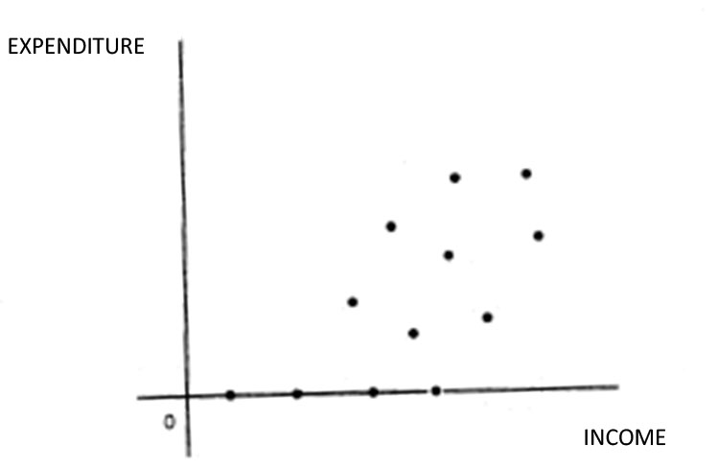
IMPORTANT POINT: There are several observations where the expenditure is zero. This feature destroys the linearity assumption. So the least squares method is inappropriate.

Slide 5
Example of censored model :
Charitable contributions[Reece (1979)]
Example of truncated model :
Suppose we have a sample of AIEEE rejects-those who scored below the 30th percentile .We wish to estimate an IQ equation
AIEEE=f( education, age, socio economic characteristics )
Some other examples :
Number of extramarital affairs [Fair (1977, 1978)]
Number of arrests after release from prison [Witte (1980)]
Annual marketing of new chemical entities [Wiggins (1981)]
Number of hours worked by a woman in the labour force [Quester and Greene (1982)]

Slide 6
AIM OF THE PROJECT
STUDYING LIMITED DEPENDENT VARIABLES
1.Study censored model
We regress pension as a function of age,education,tenure,experience & no. of dependents.
Censored because a lot of people do not receive pension. so for them pension=0 in the data.
2.Study truncated model
We regress GATE( a special programme) score on language test score and mathematics test score received by them prior to taking the GATE. Students enter GATE program only if they receive a minimum GATE score of 40.So the model is truncated.

Slide 7
METHODOLOGY AND THEORY
A limited dependent variable Y is defined as a dependent variable whose range is substantively restricted.
In the usual linear regression model we write
Y_{i=} β’X_{i} + u_{i}
Where u_{i ~} N(0, σ²)
=>Y_{i} ~N(β’X_{i,} , σ² )
=> -∞ < Y_{i} < ∞
However in many economics applications Y_{i} does not satisfy this restriction. Mostly we have Y_{i} ≥ 0
Example : Working hours ,where 0≤ Y_{i} ≤ 24
More generally , a≤ Y_{i} ≤ b.

Slide 8
To handle this problem , there are two methods :
Non linear Specification :
We write Y_{i=} e ^{β’Xi + ui}
However inference is a problem in this method.
Latent Variable Framework :
We can write it in a latent variable framework.
Y_{i}*= β’X_{i} + u_{i} , ui ~ N(0, σ² u)
Y_{i} = Yi* if Y_{i}* >0
= 0 if Y_{i}* ≤ 0

Slide 9
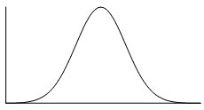
The two types of limited dependent variable models are :
Censoring occurs when the values of the dependent variable are restricted to a range of values ie. we observe both Y_{i} =0 and Y_{i} >0.
When data is censored the distribution that applies to the sample data is a mixture of discrete and continuous distribution. The total probability is 1 as required ,so we simply assign the full probability in the censored region to the censoring point ,in this case 0.
P(Yi>0)
P(Yi=0)
Truncation
In a truncated model we observe only Y_{i} > 0.Here the area under the curve
after the truncation is scaled down so that its total area is 1.

Slide 10
CENSORED MODEL ESTIMATION :
Estimation of the eq Y_{i=} β’X_{i} + u_{i} by OLS generates inconsistent estimates of β
Mathematical explanation :

Slide 11
The Inverse Mills Ratio or the hazard rate :
It is the ratio of the probability density function to the cumulative distribution function.
A common application of the inverse Mills ratio to take account of a possible selection bias

Slide 12
Intuitive explanation :
Intuitively we see that the resulting intercept and slope coefficients are bound to be different than if all the observations were taken into account

Slide 13
Maximum likelihood estimation(ML):
Censored regression models are usually estimated by
the Maximum Likelihood (ML) method
Observations:
Li is a mixture of probability and density
It depends on β and σ

Slide 14
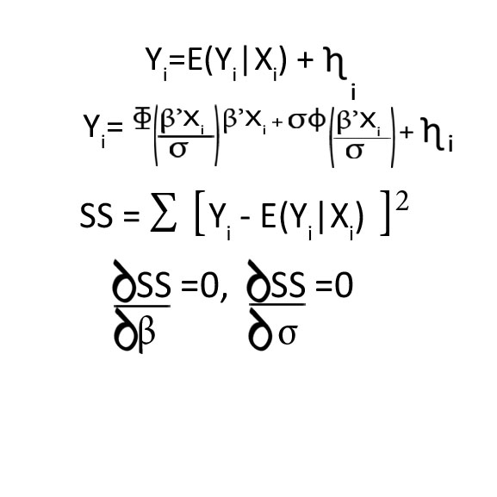
Non linear estimation :
Non linear estimation gives highly non linear equations that are difficult to solve
Difference between Ml and NlE?
In ML we assume u_{i}~ N(0, σ² )
In NLE we assume only independence of error , no assumption on distribution of errors

Slide 15
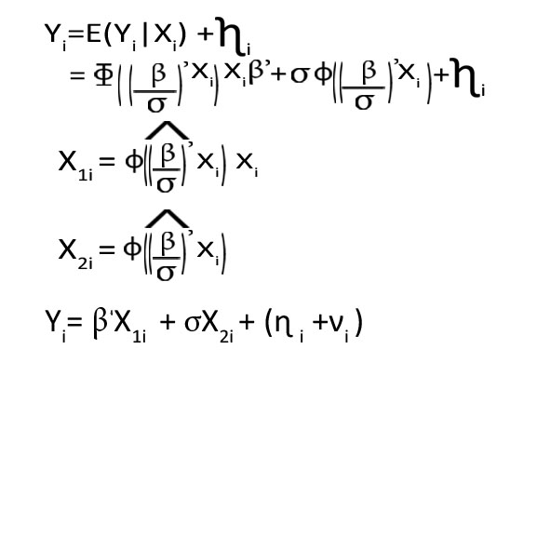
HECKMAN’S 2 step procedure
A popular alternative to maximum likelihood estimation of the tobit model is Heckman’s two-step, or correction, method.
Step 1: Use the probit estimate to compute estimate of (β / σ)
Step 2: For positive observations of Y, run a regression of Yi on X1i and X2i .
We get consistent estimates but not efficient .

Slide 16
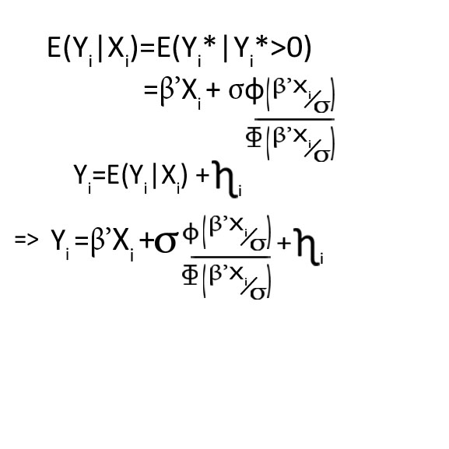
TRUNCATED MODEL ESTIMATION:
Regression Yi on Xi produces inconsistent β because of omitted variable bias.
Heckman’s 2 step not possible as we cannot turn this into a probit model and get (β/ σ) estimate
Non linear estimation is also difficult to do

Slide 17
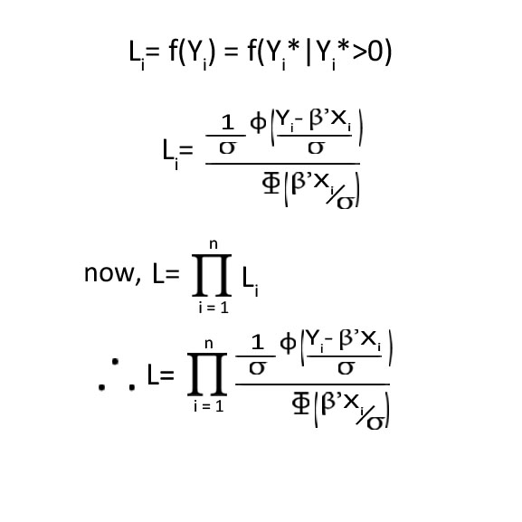
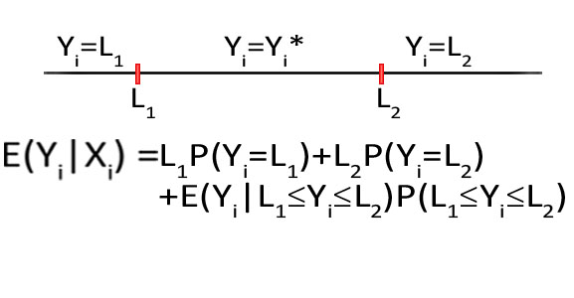
Maximum Likelihood :
Step 2 : Maximise Σ(Log N-Log D)
Step 3 : Iterate to convergence
TWO LIMIT TOBIT MODEL :
Y_{i=} β’X_{i} + u_{i}
Yi = L1 if Yi*< L1
Yi = Yi* if L1 ≤ Yi ≤ L2
Yi=L2 if Yi* ≥ L2

Slide 18
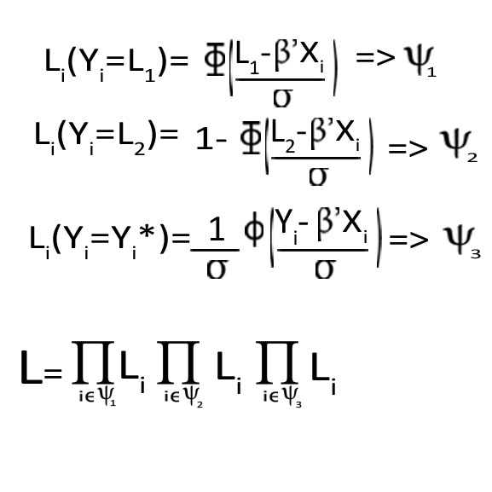
LIKELIHOOD FUNCTION

Slide 19
SAS OUTPUT AND RESULT INTERPRETATION

Slide 20
Censored model
Dependent variable- pension: $ value of employee pension
Explanatory variables- exper: years of work experience
age : age in years
tenure : years with current employer
educ : years schooling
depends: number of dependents
The sample is censored with the lower boundary being at 0.
We have 616 observations in the sample.

Slide 21
PROC QLIM
The QLIM procedure analyzes limited dependent variable models in which dependent variables take discrete or a continous range of values .
We use it for models in which the dependent variable is censored or truncated from below or above or both.
QLIM uses maximum likelihood estimation.
The model is estimated by specifying the endogenous variable to be truncated or censored. The limits of the dependent variable can be specified with the CENSORED or TRUNCATED option in the ENDOGENOUS or MODEL statement when the data are limited by specific values or variables.
The lb=(or ub=) option on the endogenous statement indicates the value at which the left (or right) truncation takes place.

Slide 22
Censored regression-Maximum likelihood SAS commands
data sasuser.censoreddata;
proc qlim data=sasuser.censoreddata;
model pension=exper age tenure educ depends;
endogenous pension~censored(lb=0);
run;

Slide 23
Censored Regression Maximum Likelihood Results
The coefficients of all the explanatory have a priori expected signs and are statistically significant at 5% level of significance.
An increase in the experience, educational attainment, tenure and the no. of dependents ,all lead to an increase in expected pension. And an increase in age leads to a decrease in expected value of pension received. Educational attainment contributes most to the increase in expected pension.

Slide 24
Heckman’s method
We specify exactly two MODEL statements when we use this method One of the models must be a binary probit model; therefore, we must specify the DISCRETE option in the MODEL or in the ENDOGENOUS statement. We base the selection on the binary probit model for the second model; therefore, we must specify the SELECT option for this model.

Slide 25
Censored regression heckman commands
data sasuser.heck1;
set sasuser.heck;
sel = (pension~=0);
run;
proc qlim data=sasuser.heck1;
model sel=exper age tenure educ depends/discrete;
model pension=exper age tenure educ depends/select (sel=1) ;
run;

Slide 26
Censored Regression Heckman’s Method Results
The coefficients of all the explanatory variables in our model have the signs expected a-priori from the theory

Slide 27
Truncated Model
Dependent variable- achiv: This is the achievement score of the students in the GATE program which is truncated at the score of 40 since students need to have a minimum score of 40 to enter the program.
Explanatory variables-langscore :language score
mathscore :maths score
178 observations in the sample.

Slide 28
Truncated regression maximum likelihood commands
data sasuser.truncateddata;
proc qlim data=sasuser.truncateddata;
model achiv= langscore mathscore;
endogenous achiv~truncated(lb=40);
run;

Slide 29
Truncated regression-max likelihood results
The coefficients of all the explanatory variables in our model a priori expected signs.
Are statistically significant at 1% level of significance.
An increase in both the language score and mathematics score of an individual leads to increase in the achievement in GATE.

Slide 30
Truncated regression summary statistics and histogram commands
proc means data = sasuser.truncateddata;
var achiv langscore mathscore;
run;
proc sgplot data = sasuser.truncateddata;
histogram achiv / scale = count showbins;
density achiv;
run;

Slide 31
Histogram of the truncated data

Slide 32
Truncated model- summary statistics and histogram results
The summary statistics of the continuous outcome variable includes the mean of achiv and its standard error .
achiv is truncated at the value of 40 since the minimum is 41.
The histogram shows this truncation.

Slide 33
CONCLUSION
Truncated and Censored Models have a wide range of economic applications ,such as the Asset holding model of Rosset ,Dividend Payment model ,Hazard Analysis etc

Slide 34
THANK YOU

