Slide 1
Lecture 1:
Networks: A brief introduction
Sudipta Sarangi
Virginia Tech

Slide 2
Networks
Network: Defines the interaction structure between agents through the set of ties between them.
  Agents: individuals, organizations, countries, represented as nodes (vertices)
  Ties: relationships between actors, represented as links (edges)
A very useful visualization tool

Slide 3
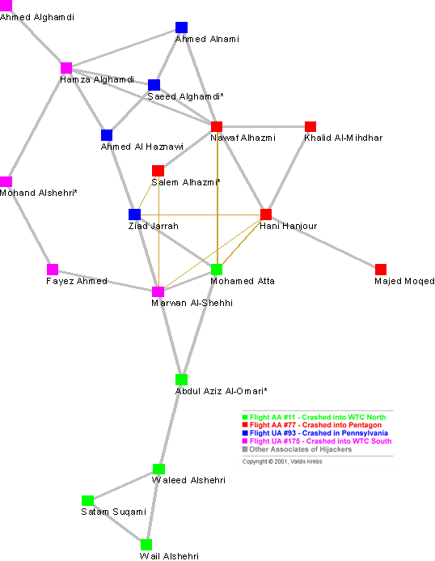
911 Terrorist’s network, Krebs (2002)

Slide 4
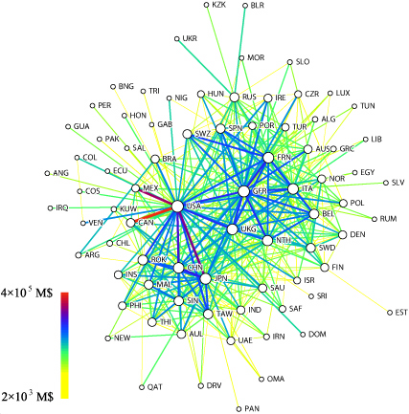
International Trade Network,
Bhattacharya et al. (2008)

Slide 5
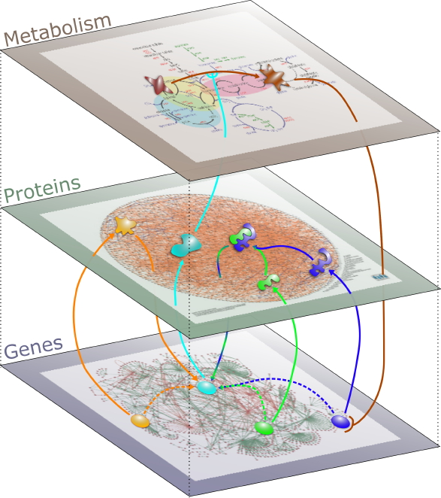
A multi-layer biological network, Institute of Biology and Technology, Saclay

Slide 6
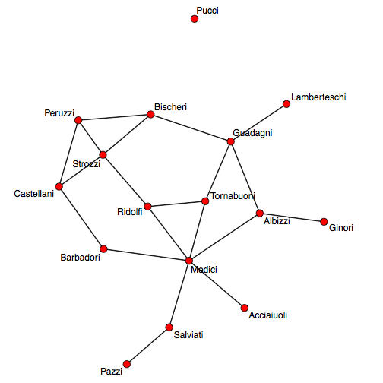
Florentine marriage network around 1430s, Padgett and Ansell (1994)

Slide 7
Florence around 1430s and the Rise of the Medici
Florence was ruled by an oligarchy of elite families: 16 families
The Medici did not have wealth or political clout but used their social relationships (particularly Cosimo de’ Medici) to rise to power

Slide 8
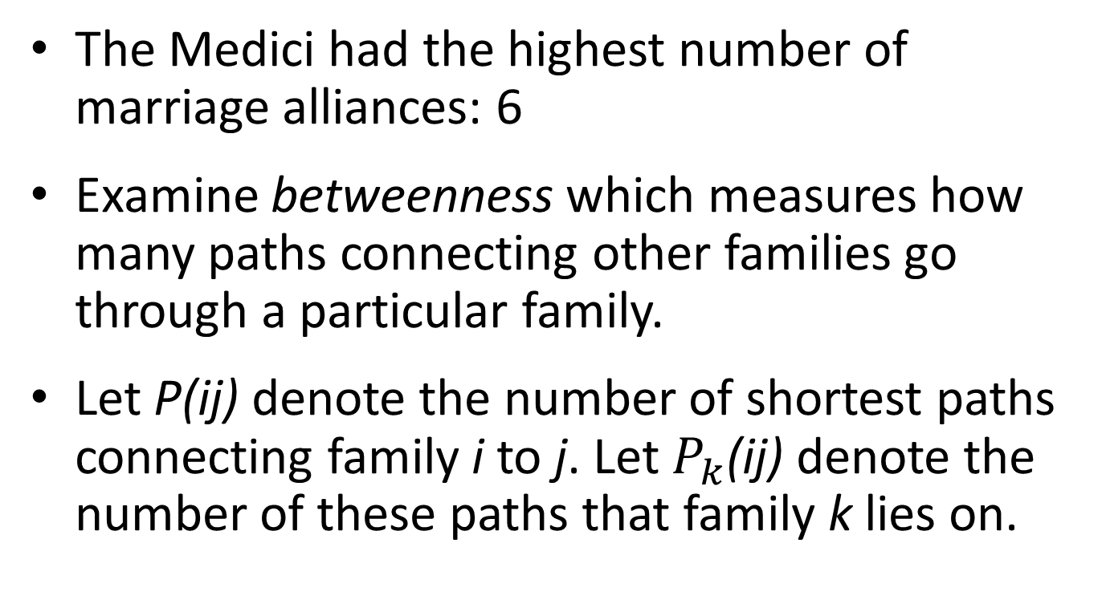
The marriage networks tells this story…
The Medici had the highest number of marriage alliances: 6
Examine betweenness which measures how many paths connecting other families go through a particular family.
Let P(ij) denote the number of shortest paths connecting family i to j. Let $P_{k}$(ij) denote the number of these paths that family k lies on.

Slide 9
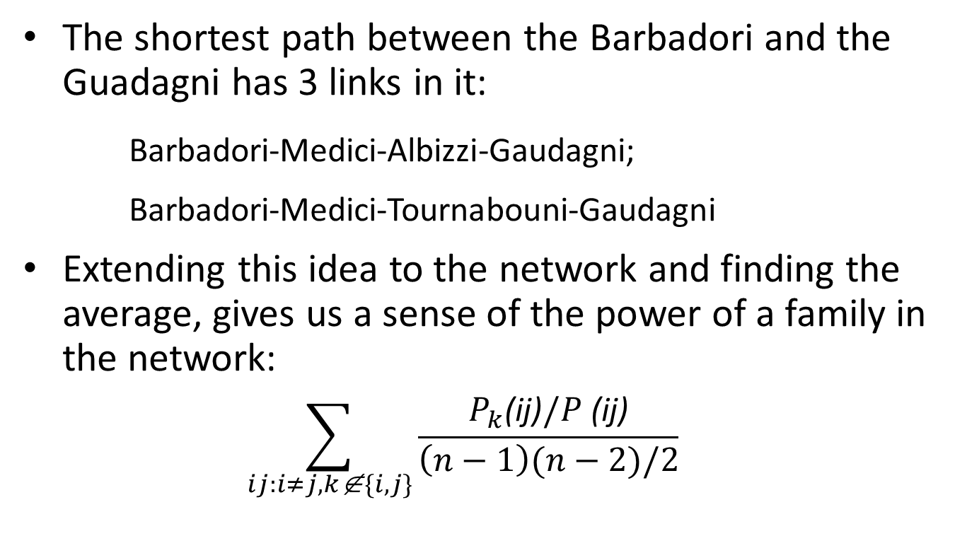
Florentine marriage network around 1430s, Padgett and Ansell (1994)
The shortest path between the Barbadori and the Guadagni has 3 links in it:
Barbadori-Medici-Albizzi-Gaudagni;
Barbadori-Medici-Tournabouni-Gaudagni
Extending this idea to the network and finding the average, gives us a sense of the power of a family in the network:
  $$\sum_{ij:i≠j,k\text{∉}\{i,j\}}{\frac{P_{k}\text{(}\text{ij}\text{)}/P \text{(}\text{ij}\text{)}}{\left(n−1\right)(n−2)/2}}$$

Slide 10
Measure of betwenness
Medici: 0.522, or the Medici lie in more than half the shortest paths between the other families!
Gaudagni: 0.255 (second highest)
Thus to the extent that marriage relationships were key to communicating information, brokering business deals and reaching political decisions, the Medici were much better positioned than other families.

Slide 11
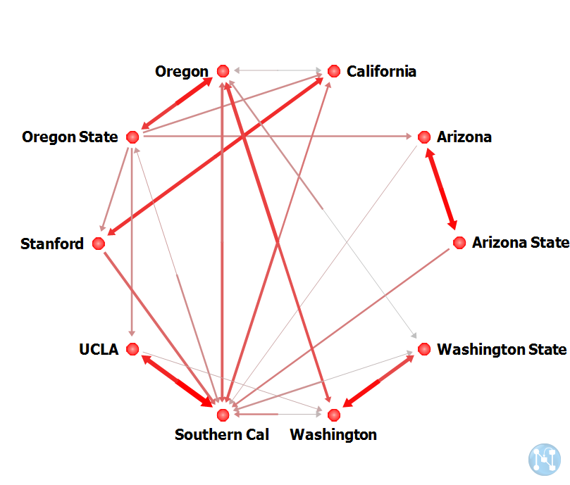
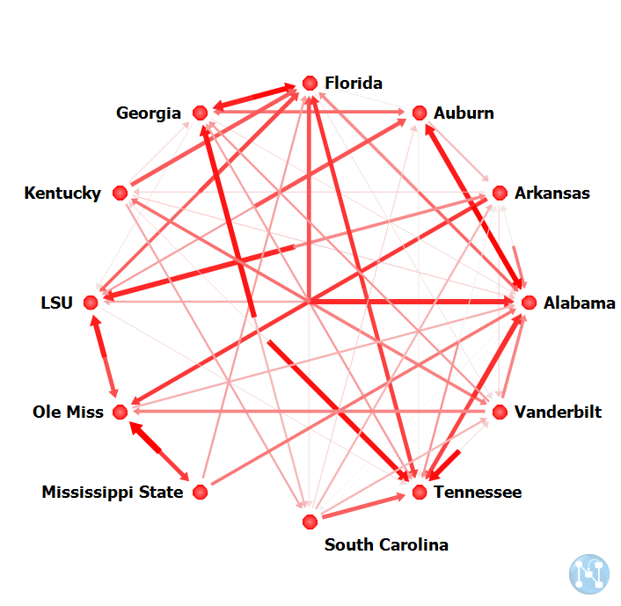
College Football Rivalry, Deck et al. (2013)
PAC 10
SEC

Slide 12
College Football Rivalry, Deck et al. (2013)
Use a clustering coefficient measure to assess which conferences present a more tightly knit rivalry network
The higher the clustering coefficient, the higher is the existence of mutual and adjacent rivalries, suggesting a tightly connected conference
Conferences with many strong teams have more pairwise rivalries

Slide 13
A Micro Measure: Centrality
Centrality is a quantitative measure which aims at revealing the importance of a node.
Formally, a centrality measure is a real valued function on the nodes of a graph.
There are many different ways to measure it!

Slide 14
A Micro Measure: Centrality
Degree centrality measures how connected a nodes is in the network.
Who is the most connected?
Who should can you talk to? Who can help you?

Slide 15
A Micro Measure: Centrality
Closeness centrality measures how easily a node can reach other nodes in the network, or
How close is someone to the others ?
Who is important locally? How long will it take for information to reach from node x to the others?

Slide 16
A Micro Measure: Centrality
Betweenness centrality measures how important a node is in terms of connecting other nodes in the network
Who can be used effectively to transfer things in the network?
Sudipta Sarangi to ...

Slide 17
911 Terrorist’s network, Krebs (2002)

Slide 18
How it matters?
This network is hard to take down. At least 6 nodes (21%) with the most numerous and important connections will have to taken out before the network will have significant damage.
Degree – measures activity or how often someone contacts others
Betweenness – measures how often someone is a go-between or control in the network
Closeness – measures access or how many people can this person reach
Atta – scores highest on all 3 measures. Al-Shehhi comes in second because he is high on degree and closeness.

Slide 19
How it matters?
Alhazmi comes in second in betweenness, suggesting that he exercised a lot of control, but fourth in activity and only seventh in closeness.
If you eliminate the thinnest links (most recent), Alhazmi becomes the most powerful node. He is first in both control and access, and second only to Atta in activity.
Hypothesis: Alhazmi played a large role in planning the attacks, and Atta came to the fore when it was time to carry them out?

Slide 20
A Micro Measure: Centrality
Centrality measure based on neighbor’s characteristics – how important or connected or influential a neighbor is: Eigen vector centrality, Bonacich centrality, Katz prestige measure.
Bonacich centrality: The centrality of a node is dependent on the centrality of the nodes it is connected to.
  How to measure Power, Influence, etc?

Slide 21
A Micro Measure: Centrality
Inter-centrality measure (Ballester, Calvo-Armengol and Zenou (2006))
Nash equilibrium is proportional to Bonacich centrality
Key player?

Slide 22
Studying Networks
Networks are a conduit for flows. These can be:
  Data; Diseases; Trade; Favors; Influence; Associations
Network models attempt to explain how these flows take place.
Networks are inter-disciplinary:
  Mathematics; Sociology; Physics; Biology; Computer science; Anthropology; Operations Research
  and more recently Economics!

Slide 23
What does Economics Bring to the Table?
How do these networks form?
Given that relationships provide benefits but are costly, why do specific networks arise?
Applying them to understand a host of phenomena – exchange, jobs, favors, information, firm behavior, etc.

Slide 24
A brief and idiosyncratic history…
Euler – the seven bridges of Konigsberg: (1736)
Emile Durkhiem and Ferdinand Tonnies – pioneered the study of social groups: late 1800s
Major developments in sociology, psychology, mathematics and anthropology in 1930s

Slide 25
A brief and idiosyncratic history…
Stanley Milgram: Six Degrees of Separation Experiment; the Oracle of Kevin Bacon
Mark Granovetter: The Strength of Weak Ties
  Structural holes
  Social capital: the social value of relationships
Frank Harrary: Formal modeling of structural issues in networks

Slide 26
A brief and idiosyncratic history…
Erdos and Reyni: Random graphs – late 1950s and ’60s
Specify the set of nodes N and a common probability p for link between any two nodes. This generates a random graph. Note that there is no bias towards any node.
Such models became popular in SNA in the 1980s to explain degree based structural effects as well as things like reciprocity, homophily and popularity.

Slide 27
A brief and idiosyncratic history…
Watts and Strogatz: Small Worlds – late 1990s
Random graph model where each node is linked to its k closest neighbors and then we randomly rewire with probability p. As p gets large we get a random network.
Has small world properties – high clustering coefficients with small average path lengths.
Examples: road maps, power grids, network of brain neurons, telephone call graphs, the networks of economists, etc.

Slide 28
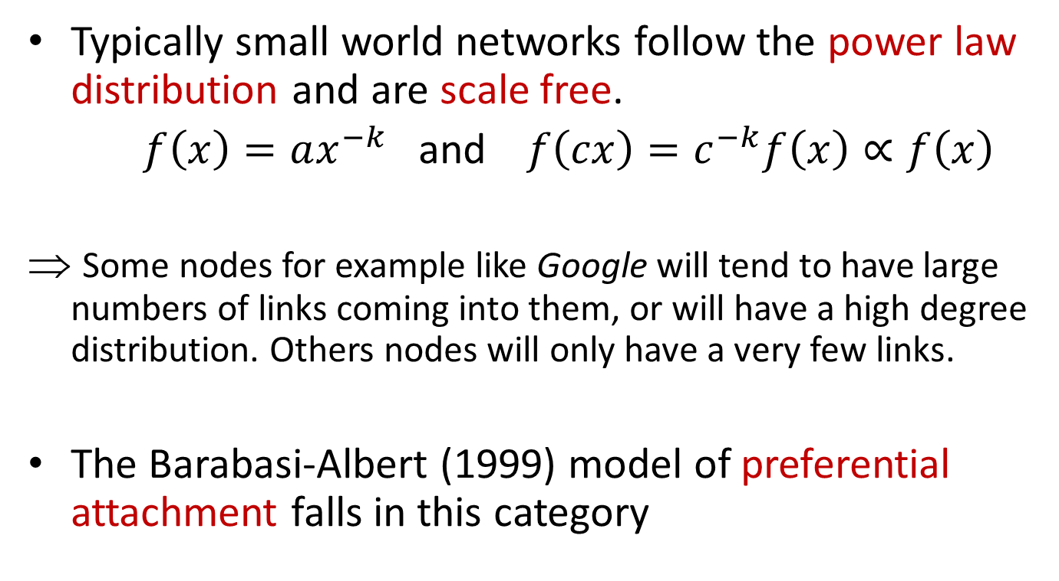
A brief and idiosyncratic history…
Typically small world networks follow the power law distribution and are scale free.
$f\left(x\right)=ax^{−k}$ and $f\left(cx\right)=c^{−k}f\left(x\right)∝f\left(x\right)$
Some nodes for example like Google will tend to have large numbers of links coming into them, or will have a high degree distribution. Others nodes will only have a very few links.
The Barabasi-Albert (1999) model of preferential attachment falls in this category

Slide 29
A brief and idiosyncratic history…
A word of caution!
Ajit, Donker and Saxena: An Example – 2012
Use corporate board data from the top 1000 Indian companies (in terms of assets) that are listed on the stock exchange
Corporate boards are a small world – or a sort of old boys network, lack diversity and are dominated by upper castes.
Alternative explanation: It is an old boy’s network not of caste but of (possibly the elite) institutions

Slide 30
Networks in Economics
Issues in network formation games:
  What is the architecture of stable networks?
  What is the architecture of socially efficient networks?
  Do these two architectures always coincide? If not why? Can we find conditions under which they will coincide?
  Do stable networks always exist, especially in pure strategies?
How networks affect behavior: Applications!

Slide 31
Networks in Economics: Approaches
Cooperative game theory approach: Coalitions of players produce output and an axiomatic approach is used to define how the output will be shared.
  Players do not have strategies. It is assumed that coalitions can write down binding agreements.
Nash networks – non-cooperative approach (Bala and Goyal, 2000a,b)
Pairwise Stability – adds consent to links between pairs (Jackson and Wolinsky, 1996)

Slide 32
Non-cooperative Network Formation aka
Nash networks

Slide 33
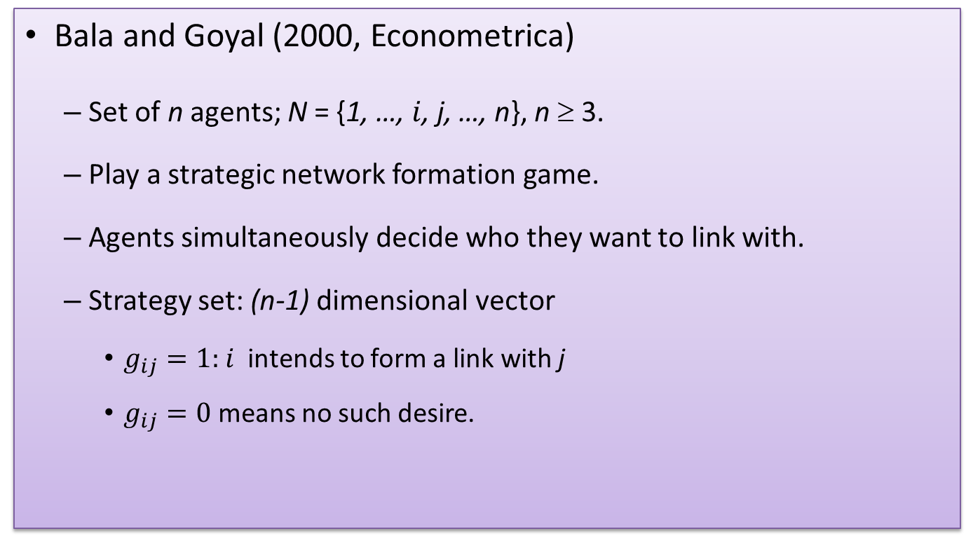
The beginning…
Bala and Goyal (2000, Econometrica)
  Set of n agents; N = {1, …, $i$, j, …, n}, n ≥ 3.
  Play a strategic network formation game.
  Agents simultaneously decide who they want to link with.
  Strategy set: (n-1) dimensional vector
    $g_{ij}=1:$ $i$ intends to form a link with j
    $g_{ij}=0$ means no such desire.

Slide 34
The game
  Agents simultaneously decide who they want to link with.
Payoffs:
  Agent that forms links pays a fixed cost (c > 0) per link.
  Agent obtains information of value V > 0 from all agents she observes “directly” or “indirectly.”
  Agent directly observes the person they are linked with (regardless of who forms the link).
  Those who an agent can reach through a sequence of links are players who are indirectly observed.
  An agent only pays for her direct links. Indirect links are free!

Slide 35
Two possible models
In the directed model (one-way flow), if i initiates a link with j then i observes j and not vice versa. The same is true for agents on indirect paths.
In the undirected model (two-way flow), if there is a link between i and j, they both observe each other regardless of who initiates the link. The same is true for indirect links. (More general payoff functions also possible!)
↑↑
This will be our focus.

Slide 36
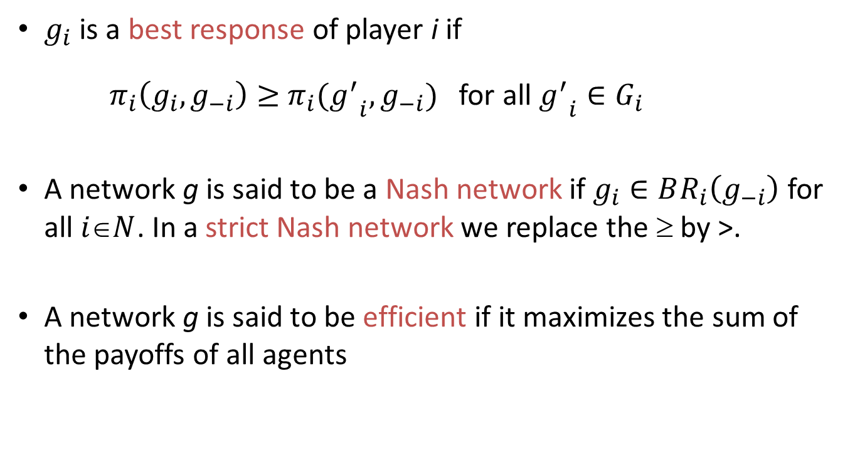
Stability and efficiency
$g_{i}$ is a best response of player i if
$π_{i}\left(g_{i}, g_{−i}\right)≥$ $π_{i}({g^{′}}_{i}, g_{−i})$ for all ${g^{′}}_{i}∈G_{i}$
A network g is said to be a Nash network if $g_{i}∈BR_{i}\left(g_{−i}\right)$ for all $iN$. In a strict Nash network we replace the ≥ by >.
A network g is said to be efficient if it maximizes the sum of the payoffs of all agents

Slide 37
Results
A Nash network is either empty or minimally connected.
Strict Nash is either (CS-) star or empty.
Efficient network is connected. Components of efficient networks are minimal. They are hard to characterize; do not always coincide with equilibrium networks.
Existence of Nash networks is an issue: Bala and Goyal show this constructively using a modified best response dynamic.

Slide 38
Heterogeneous values and costs
Galeotti, Goyal and Kamphorst (2006) - similar results for strict Nash.
Existence in pure strategies not guaranteed under cost heterogeneity. (Haller, Kamphorst and Sarangi 2007)

Slide 39
Imperfect links: Reliability
Bala and Goyal (2000b): Allow for the possibility that a link between two agents may not work.
Retain all assumptions of Bala and Goyal (2000a):
  Homogenous values and costs
  Two-way flow model
  + Each link only succeeds with a probability 0 < p < 1. Link failure is an independent event.
The main difference is that now all paths between two agents are important!

Slide 40
Imperfect links: Reliability
Characterization of (strict) Nash networks is partial.
  Key insight: Nash networks are superconnected!
  All three types of star networks are possible.
Characterization of efficient networks is partial.
Existence of Nash networks: ??
The main problem: When we add or delete a link, there is no systematic way of counting the number of new paths created.

Slide 41
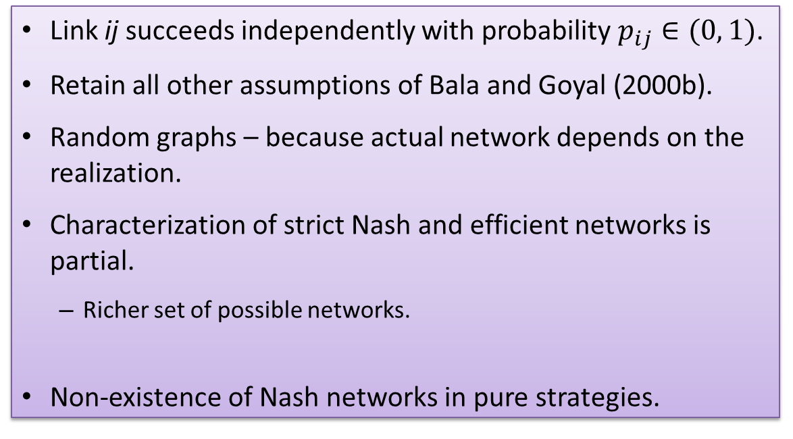
Heterogeneous link reliability
Link ij succeeds independently with probability $p_{ij}∈(0, 1)$.
Retain all other assumptions of Bala and Goyal (2000b).
Random graphs – because actual network depends on the realization.
Characterization of strict Nash and efficient networks is partial.
  Richer set of possible networks.
Non-existence of Nash networks in pure strategies.

Slide 42
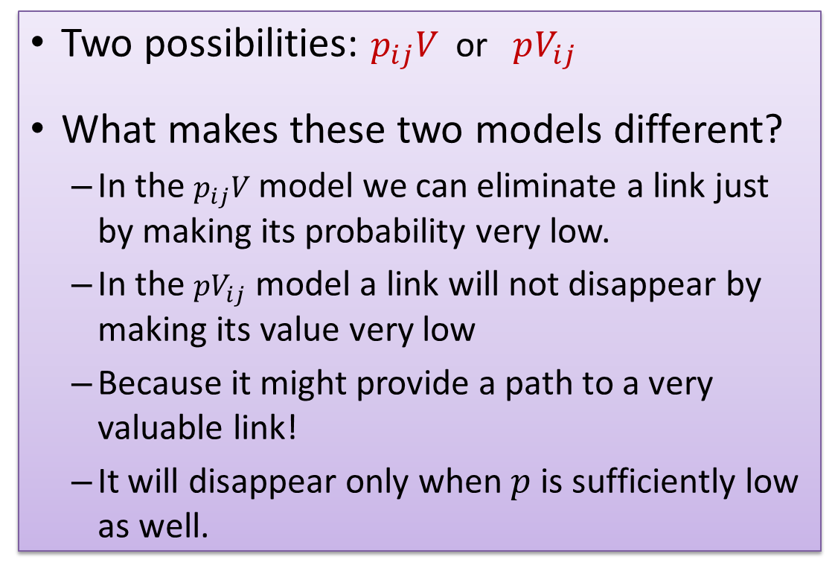
How parameter heterogeneity matters
Two possibilities: $p_{ij}V$ or $pV_{ij}$
What makes these two models different?
  In the $p_{ij}V$ model we can eliminate a link just by making its probability very low.
  In the $pV_{ij}$ model a link will not disappear by making its value very low
  Because it might provide a path to a very valuable link!
  It will disappear only when $p$ is sufficiently low as well.

Slide 43
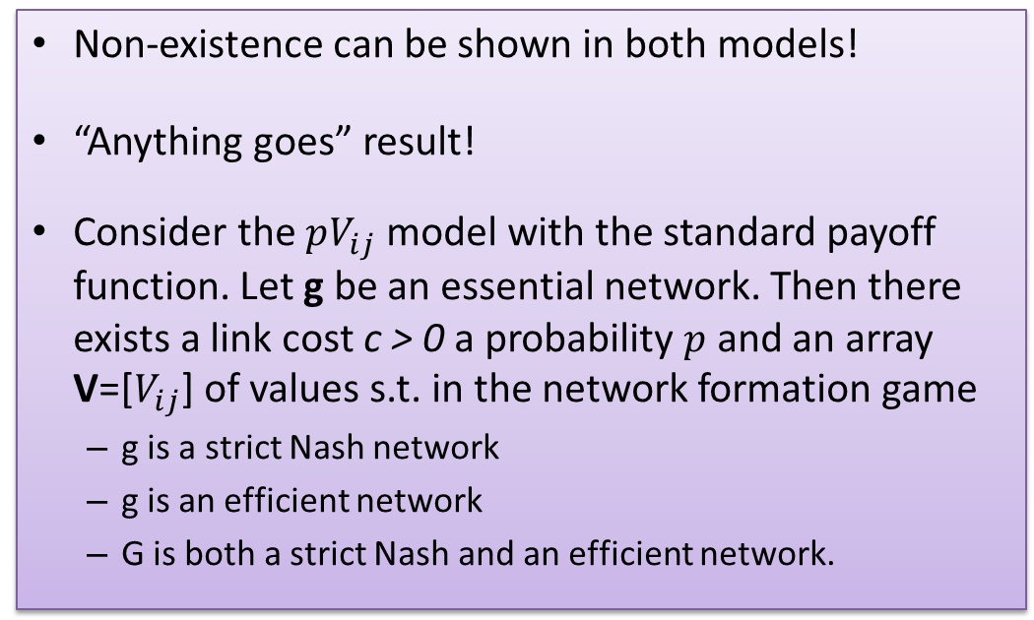
How parameter heterogeneity matters
Non-existence can be shown in both models!
“Anything goes” result!
Consider the $pV_{ij}$ model with the standard payoff function. Let g be an essential network. Then there exists a link cost c > 0 a probability $p$ and an array V=[$V_{ij}$] of values s.t. in the network formation game
  g is a strict Nash network
  g is an efficient network
  G is both a strict Nash and an efficient network.

Slide 44
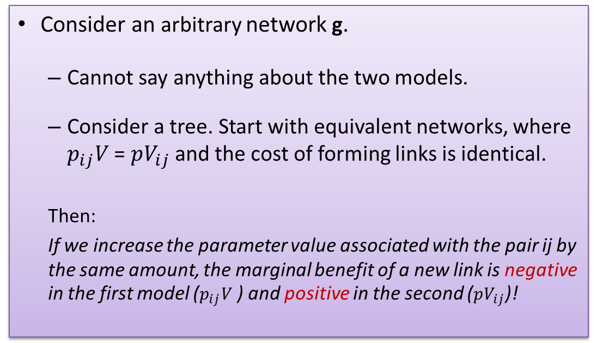
How parameter heterogeneity matters
Consider an arbitrary network g.
  Cannot say anything about the two models.
  Consider a tree. Start with equivalent networks, where $p_{ij}V$ = $pV_{ij}$ and the cost of forming links is identical.
  Then:
  If we increase the parameter value associated with the pair ij by the same amount, the marginal benefit of a new link is negative in the first model ($p_{ij}V$ ) and positive in the second ($pV_{ij}$)!

Slide 45
Imperfect links: Decay
Similar sorts of things.
Decay creates incentives for smaller diameters and shorter paths.
Stars and Core-periphery type architectures are important.
Anything goes results can be found!

Slide 46


